Slide 1

INFO 320 Final Presentation
Date: July 10, 2023
Population Profits
Matthew Gerloff, Michelle Chen, Natalie Ramdeo, Edward Reyes-Pinto

Slide 2
Story
A central factor in many business related questions is an attempt to predict what the future will look like. No business is stable without a base of customers- and we can consider our population data as the ever changing list that businesses could use as the potential customer base in the United States.
Our focus has narrowed toward analysis of Migration levels in the United States, what factors cause change in Migration levels, and how our other population statistics are impacted by Migration. The purpose of our analysis is not to solve any glaring issue, but to look for opportunity in what we can determine in future migration levels. We also want to understand why past migration was high when it was high, and low when it was low .

Slide 3
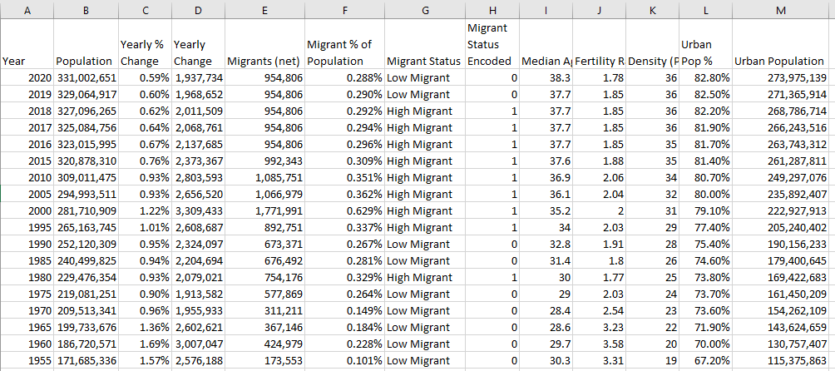
Overview

Slide 4
Setting up the Model
In order to target the Migrants column, additional columns were created:
Migrant % Population
More relevant than total Migrants, scales with country population.
Migrant Status
Average of % Migrants was 0.291%
If over the average, row was labeled “High Migrant”
If below, labeled “Low Migrant”
Migrant Status Encoded
Translates “High Migrant” to 1 and “Low Migrant” to 0
Easier for Predictor to Interpret

Slide 5
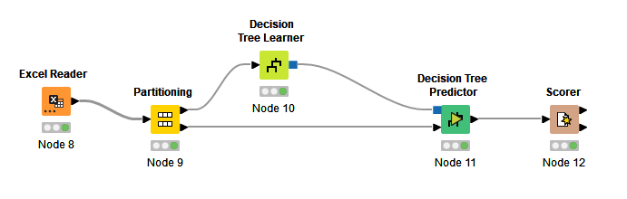
Decision Tree Model

Slide 6


Results and Scoring

Slide 7

Business Questions → Analytical Questions
Does the Migrant trend increase/ decrease at the same time as the Population of the U.S?
Can the impact of U.S. legislation be seen by analyzing the law history with migration data?
What consumer behavior and market expansion opportunities can be found from migrant data?
How could we further localize this analysis?
Notes:
Question 2 can be attributed to the Decision Tree Model

Slide 8
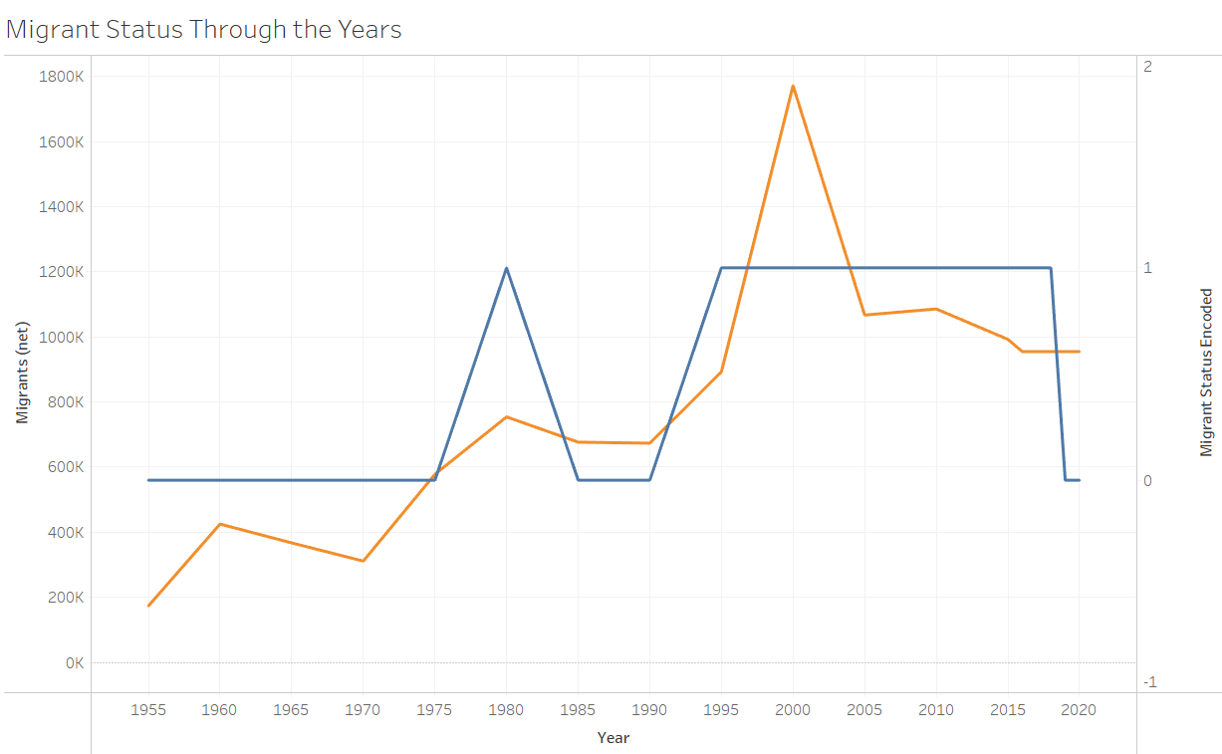

Visualizations
Notes:
This Visualization shows the trend of migrants into the US through the years. The Migrant status shows if the amount of Migrants that year was either above or below the average

Slide 9
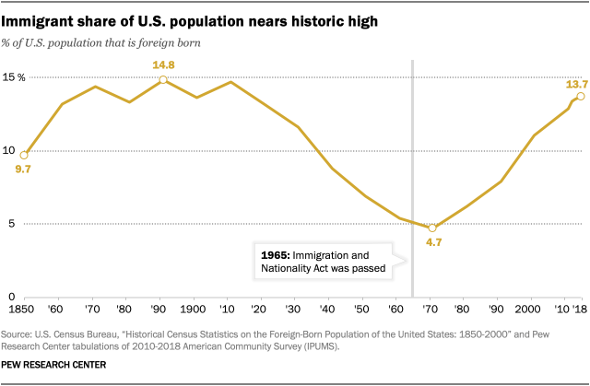
This act aimed to promote diversity by eliminating the national origins quota system and opened doors for immigrants from non-European countries, particularly Asia, Africa, and Latin America.
Since 1965, the number of immigrants living in the U.S. has more than quadrupled.

Slide 10
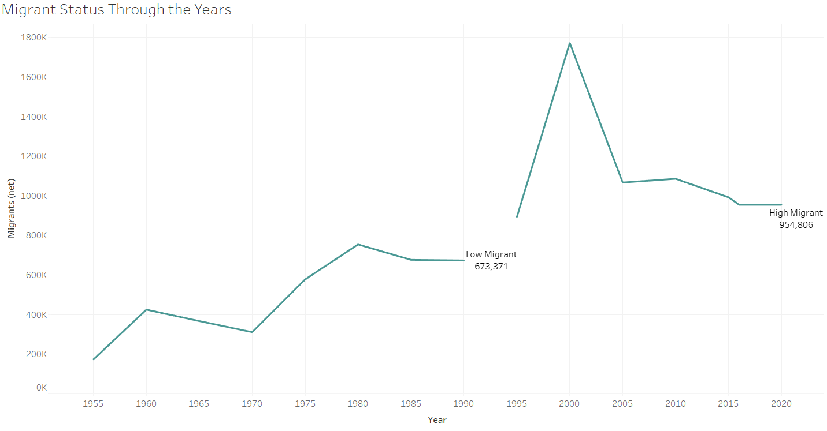
Personal Responsibility and Work Opportunity Reconciliation Act of 1996: imposed stricter eligibility requirements and created barriers for immigrants to access public assistance programs.

Slide 11
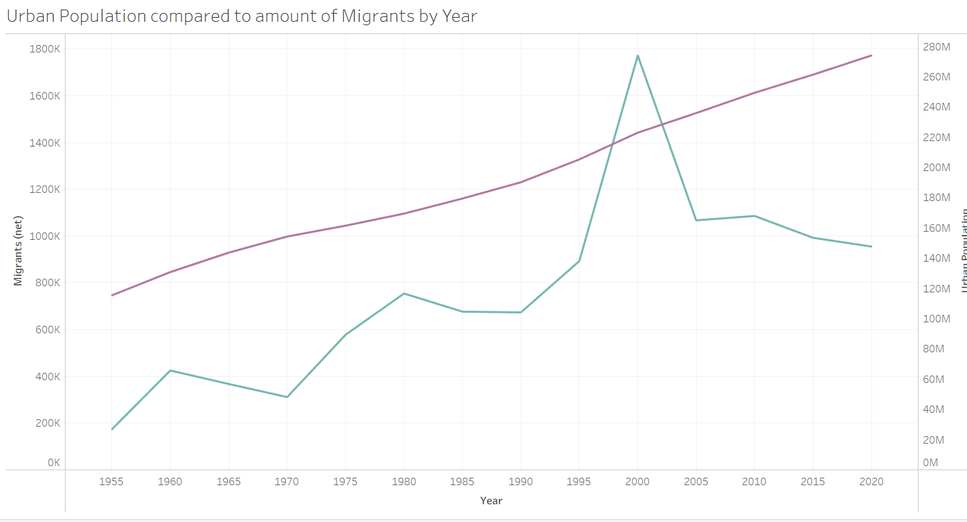


Slide 12
Insights & Analysis
High or Low Migration had no effect on the steady rise of Urban Population levels.
Peaks and Valleys in Migration data are seemingly created by the U.S. Government with laws and regulations.
New policy may soon be required as Migrant numbers are once again nearing peak levels.
This surge brings opportunities and challenges, affecting certain sectors the most:
Workforce and Labor: Immigrants continue to fill gaps in markets that had been experiencing labor shortages.
Innovation: Migrants tend to have a high drive to create businesses and advance industries, due to their diverse backgrounds, competitive nature, and new perspectives.

Slide 13

Insights & Analysis
The Impact of High Migrant Numbers (Cont.)
Spending & Demand: High Migration leads to population growth, which boosts consumer spending and demand.These increased contributions support job creation and overall market expansion.
Diversity and Global Connections: The Cultural Diversity that immigrants bring strengthens the connection that other countries have to the United States. This increased collaboration can enhance the competitiveness of the US in a higher number of areas while attracting international investments.

Slide 14


